Slide 1

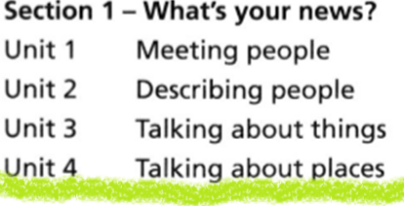

WEEK-1

Slide 2

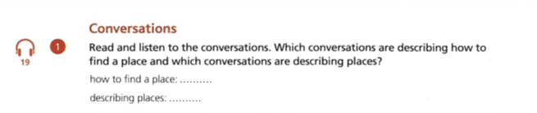

Slide 3

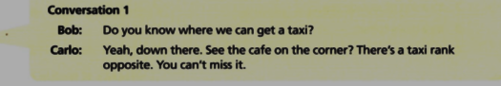
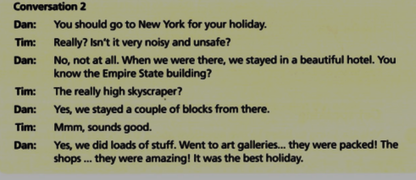
00.00-00.16
00.16-00.52

Slide 4
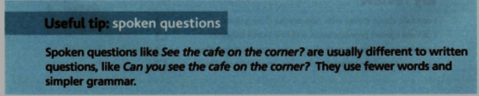
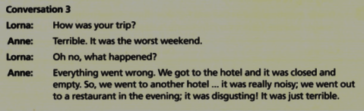
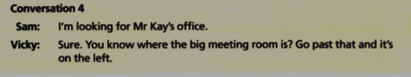
00.52-1.23
1.23-1.37

Slide 5
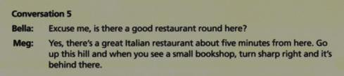
1.37-

Slide 6
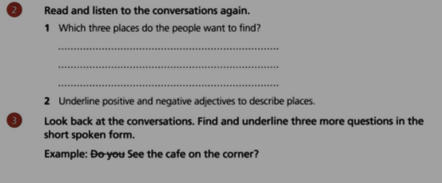

Slide 7
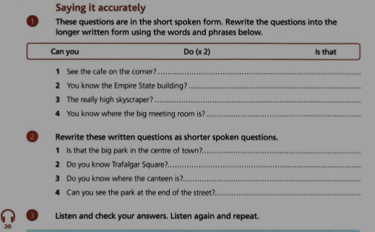

Slide 8
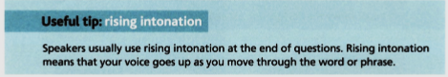
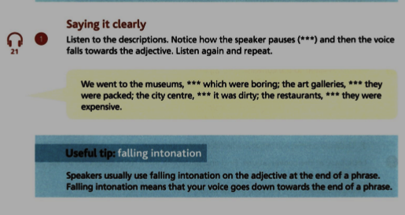

Slide 9
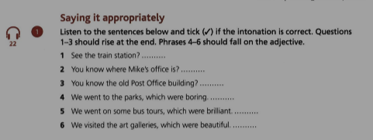

Slide 10
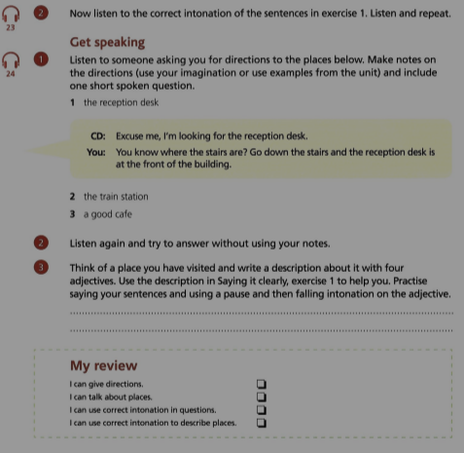

Slide 11
ASKING AND GIVING DIRECTIONS
https://www.youtube.com/watch?v=-_YoeEY8FPM
https://www.youtube.com/watch?v=2JFqKRUB2vc
https://www.youtube.com/watch?v=7W2eUcFMCU4
https://www.youtube.com/watch?v=DPYJQSA-x50 https://www.youtube.com/watch?v=7W2eUcFMCU4
https://www.youtube.com/watch?v=hoP5Ec_ERKA https://www.youtube.com/watch?v=O5rF6kvyu1g https://www.youtube.com/watch?v=2GFZ5ZKuvYg

